Slide 1
The Independent and Joint Effects of the Skill and Physical Bases of Relatedness in Diversification
Moshe Farjoun (1998)
Strategic Management Journal

Slide 2
Introduction
Relatedness
Relatedness has important research and practical implication especially on insights regarding firm diversification strategy and performance
Relatedness encompasses several dimensions (multidimensionality)
This study focuses on two important bases of relatedness:
skills and physical characteristics (Note the similarities to Penrose, 1959 for skill-base. Skills (could include managerial capacity) and physical characteristics (productive services). Also, to Teece et al., 1997; e.g. dynamic capabilities may involve both. Intangible human skills relevant to RBV and generation of strategic assets more generally.)
Q1. How do the skill and physical bases differ in the ways they identify relatedness in the same set of industries?
Q2. What are the separate and joint contributions of the two approaches in explaining firm performance differences?

Slide 3
The Independent Effects
The differences between physical and skill resources
Observability: human skill are not easy to identify (e.g. interrelated bodies of knowledge –including tacit– relevant to production process) while physical resources are more observable and identifiable; (e.g. physical processes, plants, equipment, manuals and software.)
Degree of product specificity: the range of industries to which physical resources can be applied is more limited
Identifying the way of relatedness
When relatedness is primarily in production → similarity in facilities vs. similarity in production expertise
When relatedness extends to functions and activities → similarity in research or marketing vs. similarity in procurement

Slide 4
Physical and skill-based relatedness and performance benefits
Physical base of relatedness
Economies of scope (shared manufacturing facilities)
Economies of scale (better capacity utilization of physical resources)
Human skill base relatedness
Sharing or transferring of individual skill resources and skill combinations → routines and work habits
Learning between related lines of business → cost reduction and increased differentiation and sales
Dynamic reciprocity: innovations and lessons are retained and used for future purposes. Additionally, these are learnable and can be transferred throughout the firm.
Hypothesis 1a: The level of related diversification as indicated by the physical base of relatedness will be positively associated with financial performance
Hypothesis 1b: The level of related diversification as indicated by the skill base of relatedness will be positively associated with financial performance

Slide 5
The Joint Effects
Combination of physical and skill bases of related diversification
The underpinning set of interrelationships between the diversified industries may be broader than can be identified by each base alone
Physical and skill bases interact in some value-added activities : Information or knowledge direct energy toward the transportation, transformation, or rearrangement of materials into final products
The interaction is institutionalized in organizational routines and procedures → learning increases the services derived both from the employees and from the material resources. This represents a kind of virtuous circle instantiation of the Penrose effect as the human skill-base and physical-base mutually reinforce each other in a cyclical manner.

Slide 6
The Joint Effects
Performance effects of combination of physical and skill bases
More potential relationships are identified → the range of potential benefits is extended
Where the two bases coexist and interact, potential benefits are complementary and generate cost and learning benefits
learning by doing + physical resources
transfer production skills from one line to another
→ Spreading cost and enhance learning
Hypothesis 2. The level of related diversification indicated by a combination of both the physical and skill dimensions will be positively associated with financial performance

Slide 7
Method
Data: diversified firms in manufacturing sector (SIC codes 20 to 39) that are listed in Fortune 500 for 1985. 96 total industries.
Skill base of relatedness: the extent that the firm’s sales in different lines of business are concentrated within skill-related industry groups
Occupational Employment Survey (OES) from U.S. Department of Labor Statistics
The occupational ratios: different types of human expertise needed in an industry and the extent to which they are required
The particular use of occupational profiles captures the interrelated nature of skill → OES classification of “Major Groups”
38 summary occupational variables represents a broad range of business functions and skills → The lower the measure, the more similar industries are in terms of their profiles, and the more likely they are to be clustered together
Physical base of relatedness
SIC code: a hierarchical system which uses survey data collected at individual establishment to categorize industries at the 2-, 3-, or 4-digit level of detail

Slide 8
Method
Identifying relatedness by the skill and physical bases
Two systems will agree that industries are related when they employ similar production technology (similar skills + similar physical processes)
The classification will disagree when the grouping is based on an aspect that is specific to one system (only on physical dimension or only on skill dimension)
Measures of level of relatedness
Entropy measure of diversification
Ratio of related to total diversification: RATIO (Physical), RATIO (Skill), RATIO (Joint)
Performance measures (DV)= ROA, ROS, MBOOK (proxy for Tobin’s Q), ALPHA. (Both accounting and market-based measures.)
Industry control variables: dummy variables for 2-digit SIC industry codes

Slide 9
Analyses and Results
Identifying Relatedness (Q1)
The patterns of agreement and disagreement between the classifications generally confirm the authors’ expectation
Physical relatedness occurs in vertically integrated industry relationship and when products are considered as close end use substitutes, but underlying transformation processes are different
Skill relatedness appears when industries share similar production, engineering, administration, and marketing skills but not raw materials, end use, or physical aspect of production
Agreement between classification
Complementarity effect: similarity in production as indicated by both skills and physical characteristics
Extension effect: the underlying relatedness is broader than indicated by each base alone and encompasses similarity in production; e.g. in chemical industry, similarity in production processes and skills (compl. effect) is associated with similarities in other functions (science and engineering).

Slide 10
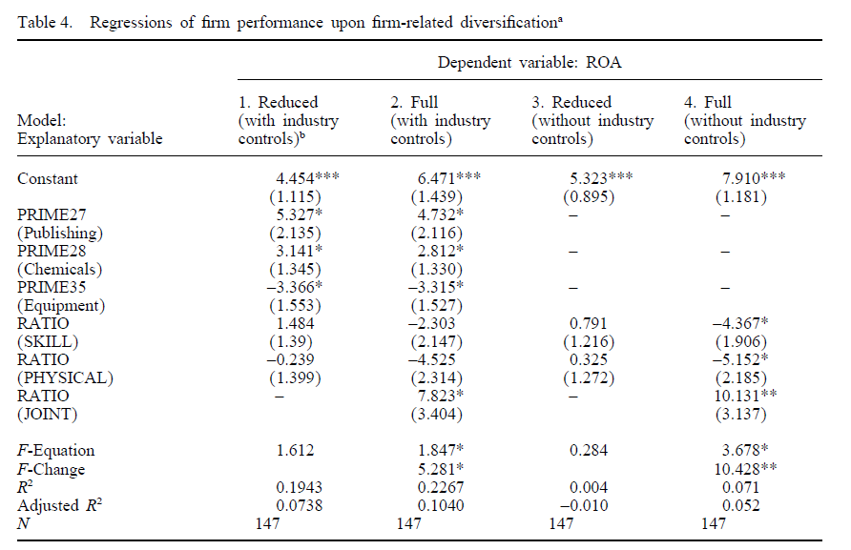
Analyses and Results
Relationship between relatedness and performance (Q2)
Hypothesis 1a & 1b are falsified
Hypothesis 2 is corroborated

Slide 11
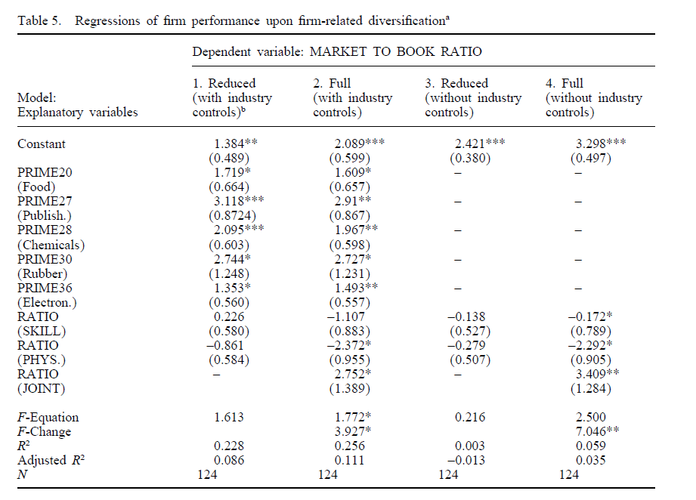
Analyses and Results

Slide 12
Conclusion and Discussion
Contributions
The empirical findings of this paper refine the understanding of relatedness as a multidimensional concept. A complete assessment of firm-level relatedness an performance requires a matrix of interrelationships across lines of business activities.
The findings regarding the identification of relatedness (Q1) support the contention that the physical aspects of production and diversification and common bodies of knowledge are distinct yet complementary bases for relatedness. Relatedness among lines of business in one aspect do not imply relatedness in another.
The findings on Q2 indicate that while independent benefits of skill-base or physical base relatedness is insignificant, there was strong effect of joint relatedness when two bases of relatedness are considered together. This jives with notions of complementarity; e.g. an interaction effect.
Limitations
Both physical and skill base relatedness is captured by external observers’ perspective not by insiders
Within-sector vertical integration is not captured
Social and political skills are not incorporated in the occupational measures

